Slide 1
Explaining Models with LIME
Alicia Wirth and Saba Mateen

Slide 2
Agenda
Basics
Image Data
Use Case
Implementation
Tabular Data
Use Case
Implementation
Comparison
Conclusion

Slide 3
Basics
Objective: Comparison InterpretML and AIX360 using LIME
Output is very fast
Can be applied to any machine learning model
Works for tabular, text and image data

Slide 4

Image Data Use Case
Classification of images according to seven members of a korean band
Obtained pre-trained model
Pickle file containing results
Image data set size: ~2.000
Classification Method: ResNet

Slide 5

Image Data Use Case
Jungkook
⇒ Input: Image
⇒ Output: Predicted member the image portrays

Slide 6
Image Data Implementation
Input image
Load pre-trained model
Transform image to Pytorch tensor
Explaining classification using LimeImageExplainer()
Apply mask to visualize classification decisions
Show mask and probability for each member

Slide 7
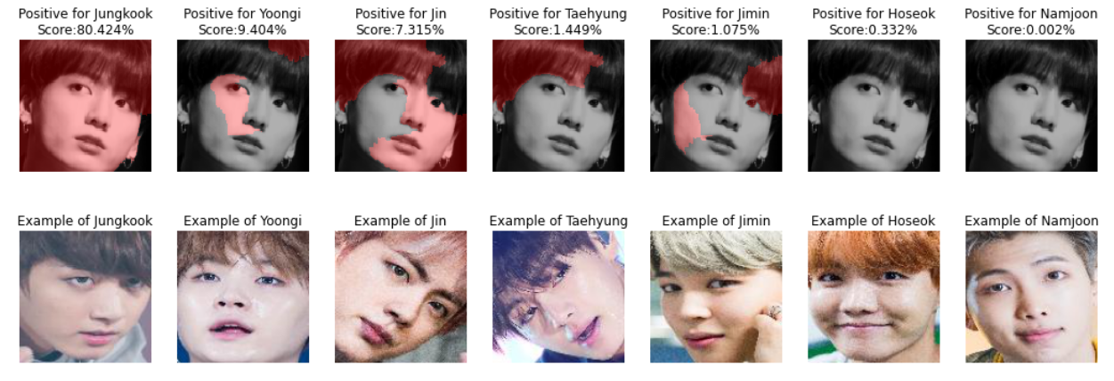
Image Data Implementation
from aix360.algorithms.lime import LimeImageExplainer
from skimage.color import label2rgb
explainer = LimeImageExplainer()
explanation = explainer.explain_instance( np.array(pill_transf(img)), batch_predict, top_labels=7, hide_color=0, num_samples=222)
temp, mask = explanation.get_image_and_mask(explanation.top_labels[0], positive_only=True, num_features=10, hide_rest=False)
plt.imshow(label2rgb(mask,temp, bg_label = 0), interpolation = 'nearest')

Slide 8
Tabular Data Use Case
Classification of images in form of tabular data according to seven members of a korean band
using result file acquired from previous use case as base
Tabular data set size: ~2.000
Classification Method: Random Forest + PCA

Slide 9
Tabular Data Use Case
eye_l eye_r nose mouth_l mouth_r
Hoseok
⇒ Input: Coordinates of facial features ⇒ Output: Predicted member corresponding to features

Slide 10
Tabular Data
Implementation
Transform pickle to csv and modify file
Input encoded coordinates of facial features
Train model with training data
Use LIME’s explanation methods for tabular data

Slide 11
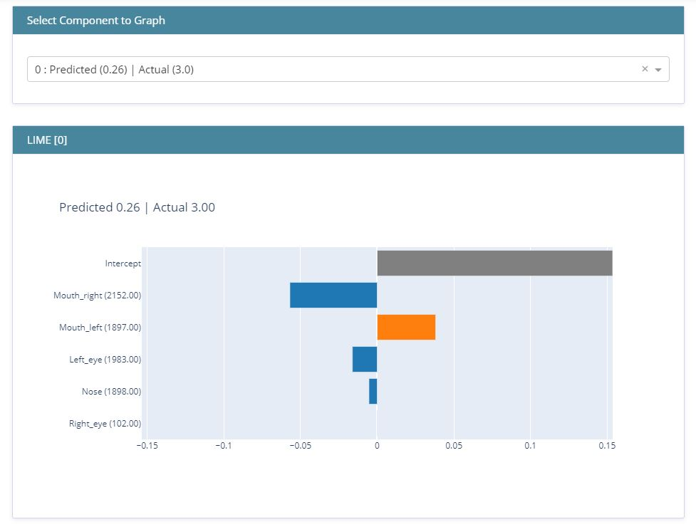
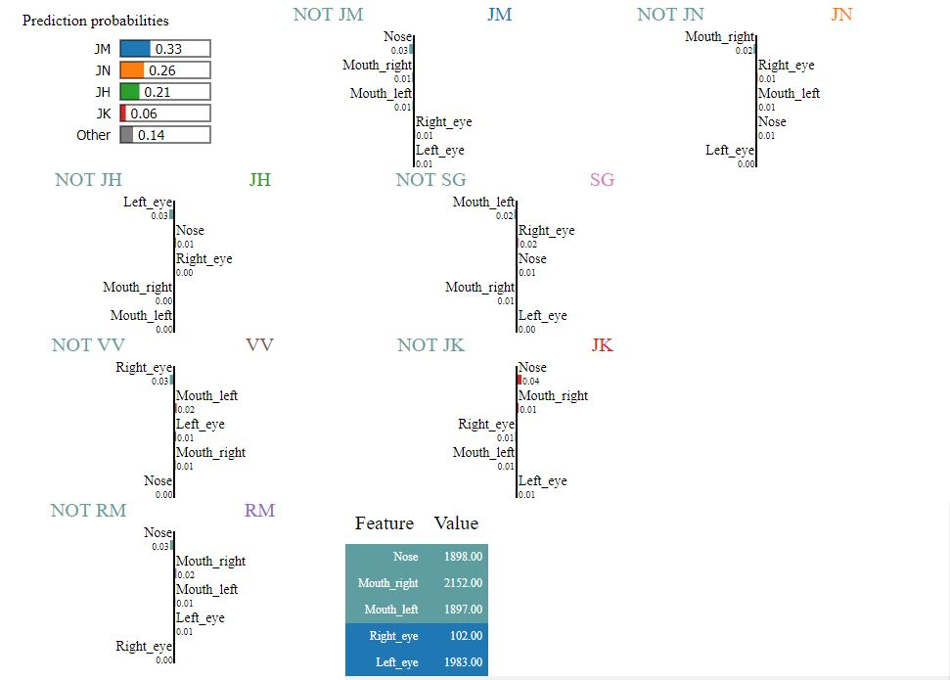
Tabular Data
Implementation
InterpretML
AIX360
from interpret.blackbox import LimeTabular
from interpret import show
lime = LimeTabular( predict_fn=blackbox_model.predict_proba, data=x_train, random_state=1)
lime_local = lime.explain_local( x_test[:10], y_test[:10], name='LIME')
show(lime_local)
from aix360.algorithms.lime import LimeTabularExplainer
explainer = LimeTabularExplainer( np.array(x_train),
feature_names = train_cols.values.tolist(),
class_names = classes,
discretize_continuous=False)
i = 0
explanation = explainer.explain_instance( np.array(x_test)[i], blackbox_model.predict_proba, num_features=5, top_labels=7)
explanation.show_in_notebook(show_all=False)

Slide 12
Tabular Data
Comparison
InterpretML | AIX360
Always selects the probability of the second class to display | Seems to select the correct probability
Unclear what exactly is displayed | Helpful captions
Can only be applied for tabular data | Can be applied to image, text and tabular data
Documentation not good | Lots of resources

Slide 13
Conclusion
AIX360 offers better fundamentals and functionalities to work with
⇒ easier for beginners
InterpretML’s LIME still seems to be in development
⇒ lacks options to analyze models for different types of data

Slide 14
Sources
Source Code: https://github.com/SabaMt/LIME-AIX-InterpretML.git
https://www.onclick360.com/interpretable-machine-learning-with-lime-eli5-shap-interpret-ml/
https://www.kaggle.com/choiseokhyeon/bts-crop2
https://de.wikipedia.org/wiki/Datei:%E2%80%98LG_Q7_BTS_%EC%97%90%EB%94%94%EC%85%98%E2%80%99_%EC%98%88%EC%95%BD_%ED%8C%90%EB%A7%A4_%EC%8B%9C%EC%9E%91_(42773472410)_(cropped).jpg
https://commons.wikimedia.org/wiki/File:Jeon_Jung-kook_at_Golden_Disk_Awards,_5_January_2019_07.jpg

